Slide 1

Animadopt:
A Short-distance Animal Adoption Dapp
EECE571G Group 8
Li Ju, Runze Wang, Shanny Lu, Shijun Shen
Notes:
‹#›

Slide 2
OUTLINE
Introduction & Motivation
Objective
Background
Related work
Comparsion
Project Design
Target Users
Use Case Task Design
Demo
Future Improvement

Slide 3
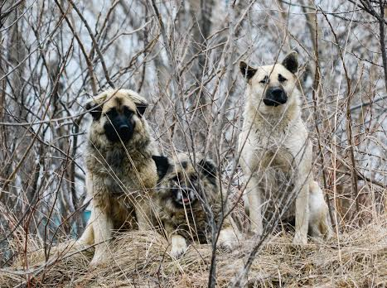
Introduction & Motivation
Stray animal issues’ negative Impacts:
Noise pollution, feces garbage and traffic accidents；
Threaten human health and lives, rabies.
The World Health Organization estimates:
200 million+ stray animals worldwide;
55,000 people die from rabies every year;
Available solution:
Sheltering, killing, vaccinating and neutering, non-governmental rescue actions and programs.
Notes:
Stray dogs have many negative impacts on city environment and human health. Stray dogs cause noise pollution, feces garbage and traffic accidents. Among Detroit’s many problems, this one tugs at the heart strings: thousands of stray dogs roaming the streets at night. And Michigan is ranked 23rd in the states caught in fighting dogs [4]. Stray dogs can cause a collision when dogs run into the road, which might even result in injury to other people and also to itself [5]. Moreover, stray dogs have become a bigger threat to human health and lives. Stray dogs can transfer and spread Rabies a deadly disease [7]. The World Health Organization (WHO) estimates that there are more than 200 million stray dogs worldwide and that every year, 55,000 people die from rabies. Detroit ranked sixth last year for dog attacks in the U.S [8]. In Los Angeles County and City alone, about 200,000 residents were bitten by abandoned dogs in one year [4,5].
With the problem of stray dogs appearing, there are many spontaneous organizations and programs to rescue them, for example, the Detroit Dog Rescue (DDR), and the CNR (collect-neuterreturn) program of stray dogs. However, according to the current situation, these options can’t effectively solve stray dog problem in our cities. So, these options are not better solutions.

Slide 4
Objectives
To reduce the amount of stray animals by helping them to find their rightful owner;
To encourage pet-lovers volunteers to participate in charity activities to help the stray animals;
To help pet owners find their lost pets by allowing owners to share the pictures of their lost animals.

Slide 5
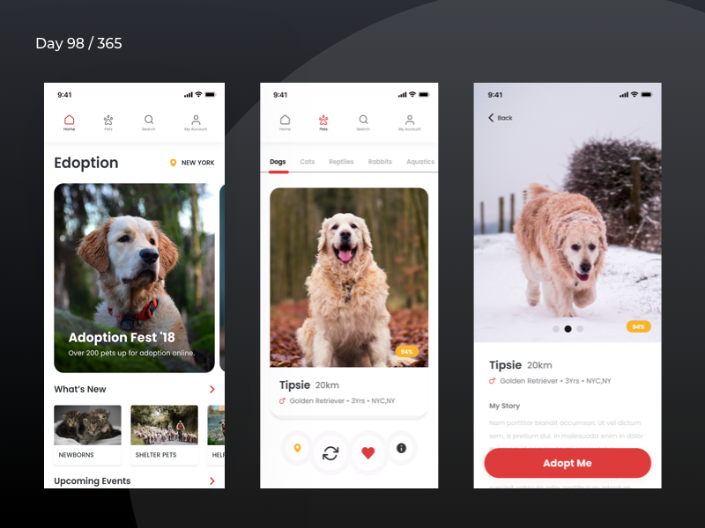
Background - Related work
Edoption
Traditional Animal Adoption Mobile App
Notes:
Many works have been conducted to assist animal adoption, especially the traditional mobile app. As you can see in the figure, the app, Edoption, is one of those current animal adoption application. It allows users to browse through available stray animals nearby. User can swipe right to like a pet or adopt it. Just like Tinder.
However, there are still some limitations in these type of traditional database animal adoption application. [Next Slides]

Slide 6
Background
- Comparison between traditional database app and Dapp
Traditional Database App Cons:
Mutability
Data Tampering
Opaqueness
Reliability
Money Tracking
Dapp Pros:
Security/Immutability
Transparency to Users
Cost Reduction
Open Source

Slide 7
Project Design
Target Users
Stray animal reporters;
Animal adopters;
(Future work) Animal adoption organizations.
Animadopt:
A Short-Distance Animal Adoption Dapp
Notes:
I’d like to talk about We proposed a stray animal adoption Dapp based on blockchain. This cute cat sitting in the box supported by a hand is our app logo
I’ll introduce you to our Dapp from two perspectives.
First one I’d like to talk about our Target users. We aim to build a platform for warm-hearted pet-lovers to take action in helping stray animals find their new home in a more convenient and safer way.
So in this project, Animals-lovers can play the role of stray animal reporters, animal adopters to join our animal adoption community.
In the future, we anticipate to allow animal adoption organizations to our community, they can contribute to our community by providing professional help to any issues, and we will also benefit them since, for example, they can raising funds from animals lovers on this platform more efficiently.

Slide 8
Project Design - Use Case Task Design
User registration and login;
Create an account called Account1-> Sign in that account -> Check User Profile Page -> Change Username -> Change Password -> Sign out -> Sign in with New Password and New Username
Post stray animal information;
Sign in with Account1 -> Post An Animal Info -> Check the New Animal Info Marker -> Log out
Place order on a specific stray animal.
Create an account called Account2 -> Sign in with Account2 -> Check Animal Info Marker on the Map -> Click Adopt Button -> Confirm Order -> Check My Transaction History ->Log out
Sign in with Account1 -> Check My Transaction History -> Log out
Notes:
We define three typical user cases for our dapp.
First one is user registration and login.
Use case 1: Create an account named Account1-> Sign In that account -> In our user Profile Page, we can change Username and Change Password -> After that we Sign out and then Sign in with New Password and New Username
The second one is about posting stray animal information
User case 2: Sign in with Account1 we created in the previous case -> Post An Animal Info -> After that, we go back to the main page, which is a map, we should see if there’s a new marker indicating the animal we just posted-> Log out
This third one is about placing order to adopt specific stray animal
Use case 3: Create a new account called Account2 -> Sign in with Account2 -> Check Animal Info Marker on the Map, we should see a marker which we posted with account 1-> Click Adopt Button and Confirm Order -> we go back to the user profile page, in My Transaction History, there should be a new transaction which is exactly the transaction we just made->Log out
Use case 4: Sign in with Account1 -> Check My Transaction History ( we can see there is an transaction which should be account2 adopting the animal account 1 posted)-> Log out

Slide 9
Demo
<A demo about how the Animal Adoption Dapp: Animadopt works>
Notes:
Now I’ll let my teammate, shijun show you a live demo about our dapp to help you better understand this process.
Password must be confirmed
Password format
reveal password

Slide 10
Future Improvement
Add CSS prroperties
Improve image size which could be processed
Add Location search bar on the map layout
Automatically log out when user is inactive, refresh page
Enable users chatting tools
Enlarge target user group, such as non-profits organization

Slide 11
Reference
[1] Canada Animal Shelter Statistics Report https://humanecanada.ca/wp-content/uploads/2020/11/Humane_Canada_Animal_shelter_statistics_2019.pdf
[2] L.Conway. “Blockchain Explained” Investopidia. https://www.investopedia.com/terms/b/blockchain.asp (accessed April. 12, 2021)
[3] Zheng, Zibin, et al. "Blockchain challenges and opportunities: A survey." International Journal of Web and Grid Services 14.4 (2018): 352-375.

Slide 12
Thanks for you listening!

Slide 13
Questions?

